Slide 1
Ice Scouting CubeSat
ISCube
Josiah Delange, Seth Merrifield, Thomas Georgiou,
Alec Forsman, Yunus Agamawi, Haley Rorvick,
John Jackson, Keegan Clay

Slide 2
Agenda
Josiah DeLange
Overview
Approach
Project Plan and Budget
Design Walkthrough
FMEA and Safety Analysis
Standards
Conclusion
Overview | Approach | Project Plan | Design Walkthrough | FMEA and Safety | Standards | Conclusions

Slide 3
Overview
Josiah DeLange
Mission Goals
Remotely detect water with a 6U CubeSat
Characterize energy spectrum of gamma ray photons
Supplement a broad range of envisioned deep space missions
[e.g. asteroid scouting, interplanetary reconnaissance, long-range sample return]
Implied Requirements
Compact, low-power, low-cost
Detection accuracy sufficient for relative navigation
Ability to relay payload information to other spacecraft
6U deployment mechanism
Overview | Approach | Project Plan | Design Walkthrough | FMEA and Safety | Standards | Conclusions

Slide 4
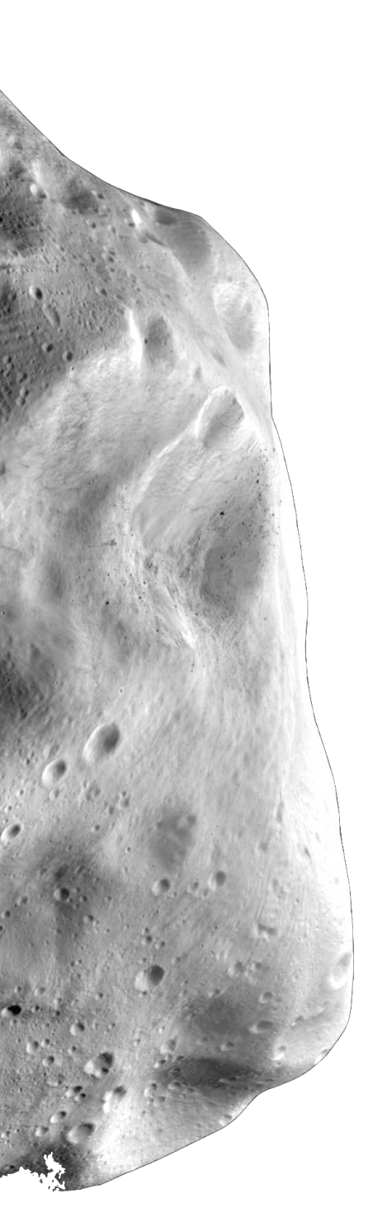
Overview
Josiah DeLange
On-board Processor
Power Control
Data Acquisition
Neutron spectrum
Gamma-ray photon spectrum
Radiation background
Communication / Data Relay
Navigation E.K.F. State Vector
x(t) = [r v]^{T}
x(t) = f(x(t),t) + u(t)
Propulsion
Attitude Control
Orbital Trajectory
Overview | Approach | Project Plan | Design Walkthrough | FMEA and Safety | Standards | Conclusions

Slide 5
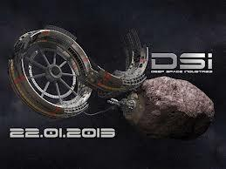

Motivation
Companies interested in asteroid mining
Planetary Resources
Deep Space Industries
Detect valuable resources for future missions
Minerals
Rare Metals
Structural Materials
Gases
Water - primary goal
Overview | Approach | Project Plan | Design Walkthrough | FMEA and Safety | Standards | Conclusions

Slide 6
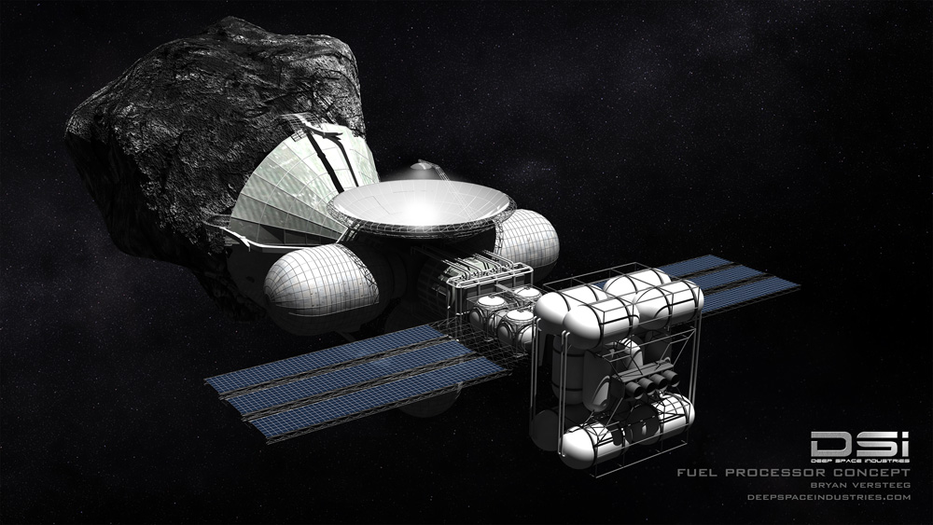
Motivation
Protection from solar radiation
Sustain life systems
Breathable air
Hydration
Facilitates the mining of other materials
High mass ratio payback
Can be converted into fuel propellant
Cost to bring water from surface of Earth to space = $23,000/lb
Estimates for water-rich(~8%), 500m wide asteroid
80 times more water than the worlds largest supertanker
200 times the rocket fuel required to launch all rockets in history
Net worth of $50 Billion - conservative estimate
Overview | Approach | Project Plan | Design Walkthrough | FMEA and Safety | Standards | Conclusions

Slide 7
Requirements
Josiah DeLange
Navigation accuracy of one kilometer
DSN’s accuracy is one kilometer
Goal is to supplement + mitigate DSN loss
Photon binning down to 0.1 us
Enables the navigation accuracy of one kilometer
Distance of 0.5 km from 2009 BD
Enables sufficient SNR for detection
Internal payload temperature between 0 and 40 ºC
Mass limit of 12 kg
Dimensional limits of 12x24x36 cm
CubeSat design restrictions
Radiation tolerant components
Overview | Approach | Project Plan | Design Walkthrough | FMEA and Safety | Standards | Conclusions

Slide 8
Project Approach
Overview | Approach | Project Plan | Design Walkthrough | FMEA and Safety | Standards | Conclusions

Slide 9

Approach
Seth Merrifield
Main goal: acquire meaningful data
Subsystems to facilitate goals
Off-the-shelf
Goal to focus on mission, not subsystem hardware
Power-centric
Fundamental to nano-satellite design
Industry and faculty support
Overview | Approach | Project Plan | Design Walkthrough | FMEA and Safety | Standards | Conclusions

Slide 10
Project Plan and Budgets
Overview | Approach | Project Plan | Design Walkthrough | FMEA and Safety | Standards | Conclusions

Slide 11
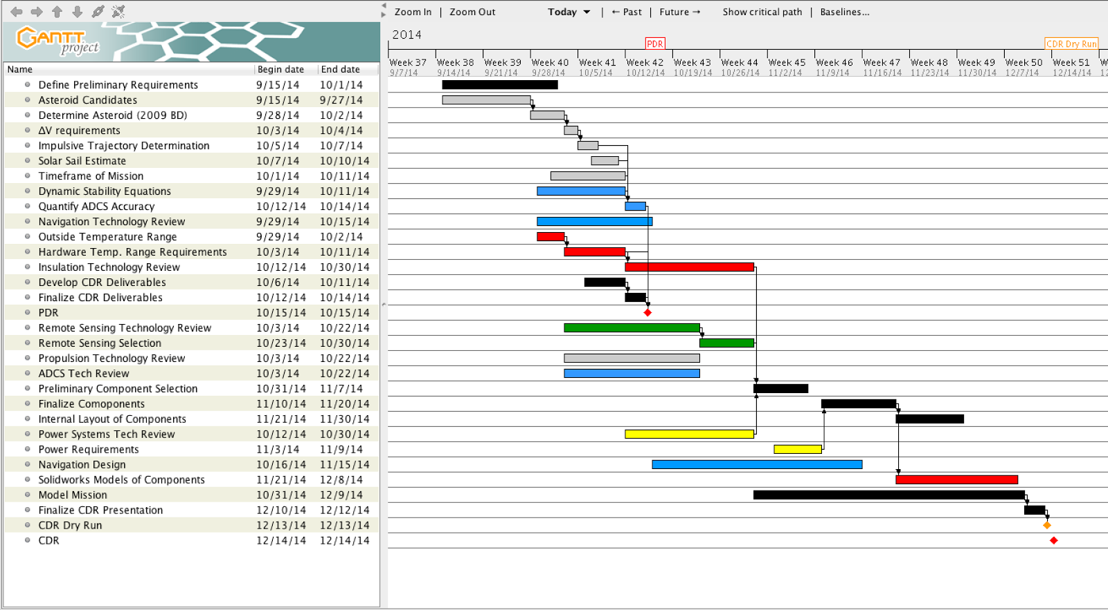
Overview | Approach | Project Plan | Design Walkthrough | FMEA and Safety | Standards | Conclusions

Slide 12
Project Budget | Full
Haley Rorvick
Subsystem | Equipment | Cost
Navigation/ Communication | S-Band Transceiver, S-Band Patch Antenna | $21,000
Propulsion | CubeSat Ambipolar Thruster | $30,000
Power | Solar Panels, Batteries | $55,400
Attitude Determination | iADCS-100 | $40,000
Detection | Photodiodes, Borated Plastic, Lithium Glass, Pulse Processor | $2,000
Thermal | MLI, Thermal Conducting Pads | $700
Structural | 6061-T6 Aluminum (various dimensions) | $100
Total CubeSat Materials Cost:
$149,200
Compared to Large Satellite Cost:
$250 million
Overview | Approach | Project Plan | Design Walkthrough | FMEA and Safety | Standards | Conclusions

Slide 13
Schedule | HASP Build Components
John Jackson
Gamma ray detector
1-U Solar panel characterization
Arduino writing to SD card
4 different setups
How does shielding against radiation affect it?
Similar design challenge to actual CubeSat
Tasks to be assigned
Overview | Approach | Project Plan | Design Walkthrough | FMEA and Safety | Standards | Conclusions

Slide 14
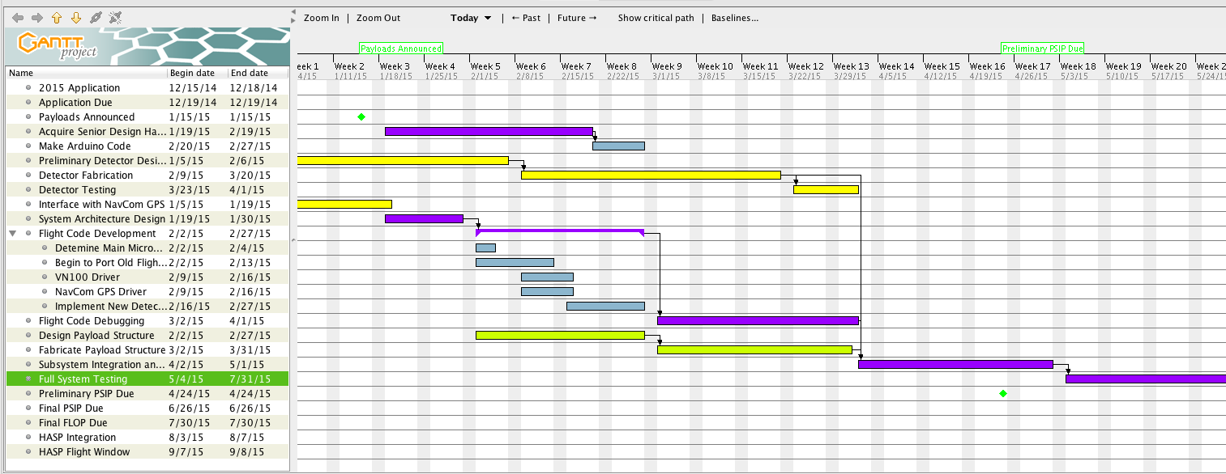
John Jackson
Overview | Approach | Project Plan | Design Walkthrough | FMEA and Safety | Standards | Conclusions

Slide 15
Project Budget | HASP Build
John Jackson
Equipment | Price
Arduino Uno (5) | $125
SD Card Shield (5) | $75
1-U Solar Panel | $2250
Wires and connectors | $30
Detector Material | $2000
Total | $4480
GPS donated by NavCom. Other materials needed will be procured with the assistance of Seth Frick, project manager, and our faculty and industry partners.
Overview | Approach | Project Plan | Design Walkthrough | FMEA and Safety | Standards | Conclusions

Slide 16
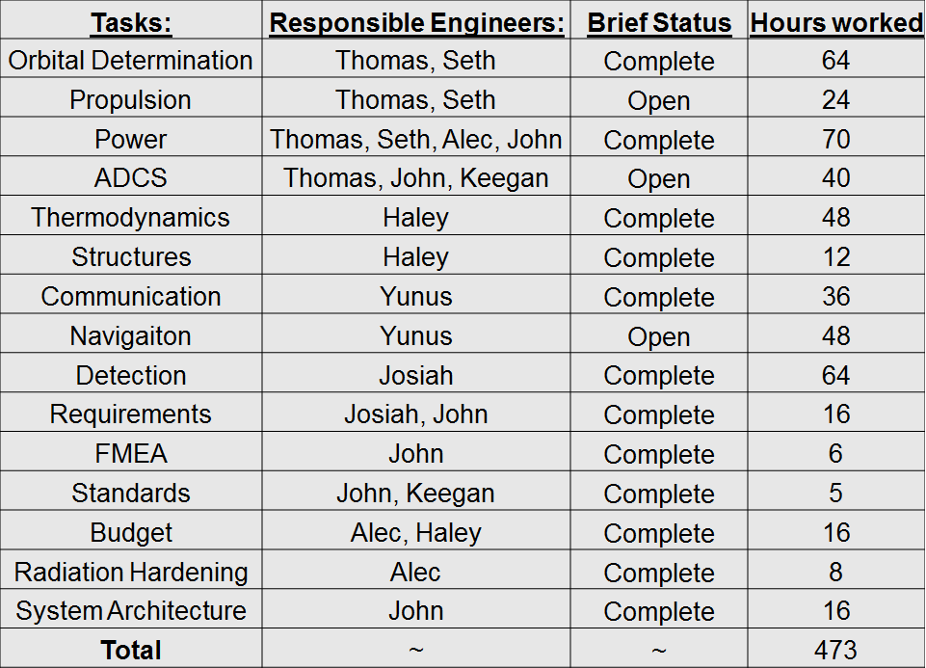
Yunus Agamawi
Overview | Approach | Project Plan | Design Walkthrough | FMEA and Safety | Standards | Conclusions

Slide 17
Design Walkthrough
Overview | Approach | Project Plan | Design Walkthrough | FMEA and Safety | Standards | Conclusions

Slide 18
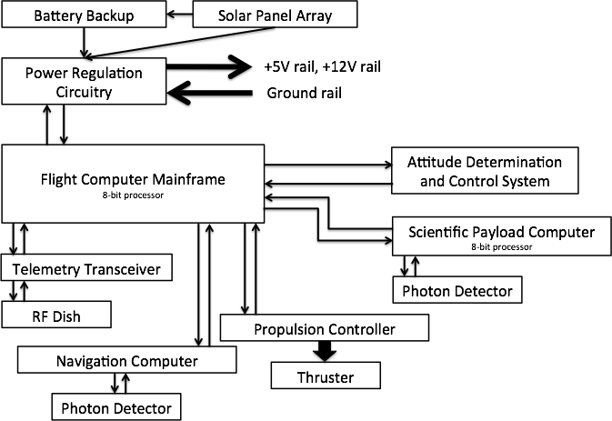
System Overview
John Jackson
Basic System Information
CAN bus for inter-sensor communication
Power regulated and delivered from PRC
FCM hands off commands and performs calculations
32-bit uC Flight Computer
Overview | Approach | Project Plan | Design Walkthrough | FMEA and Safety | Standards | Conclusions

Slide 19
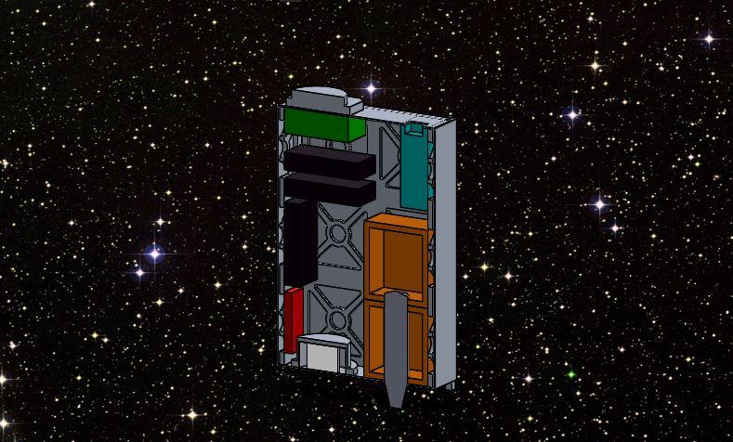
CAD Model Overview
Haley Rorvick
S-Band Patch Antenna
S-Band Patch Antenna
S-Band Transceiver
Batteries
ADCS
Processor(s)
Fuel Tank
Detector
Thruster
Overview | Approach | Project Plan | Design Walkthrough | FMEA and Safety | Standards | Conclusions

Slide 20
Finding Water
Josiah DeLange
Spectral Analysis
Emitted radiation contains traces of known elements
Neutron/gamma interaction (neutrons suggest water ice)
Presence of gamma radiation
“Fast” neutrons (~ 1 MeV)
Interact with hydrogen-rich materials
Use organic plastic material to detect
Wavelength for max emission: ~430 nm
“Thermal” neutrons (~0.025 eV)
Interact with isotopes of lithium
Use lithium-doped glass material to detect
Wavelength for max emission: 386 nm
Overview | Approach | Project Plan | Design Walkthrough | FMEA and Safety | Standards | Conclusions

Slide 21
Typical Counter Setup: Photomultiplier Tube
High-energy
particle
Photocathode
Dynodes
Anode
R
R
R
R
V_{B}
Scintillator
1 electron
10⁶ electrons
“Dynode Chain” PMT
Josiah DeLange
Overview | Approach | Project Plan | Design Walkthrough | FMEA and Safety | Standards | Conclusions
Notes:
Initial electron is accelerated toward first dynode (high bias voltage induces electric field)
Additional electrons produced due to electron avalanche process
Etc; resulting gain of roughly 10⁶
Pros
Ideal for small signals, i.e. single particle detection
Resulting electric signal is sufficiently amplified
Cons
Physical size (larger PMTs require a higher bias voltage)
Sensitivity to magnetic fields
Power requirements

Slide 22
Small Counter Setup: Avalanche Photodiode
Cathode
Reflective PTFE tape
High-energy
particle
Light Pulse
Aluminum Housing
N
P
Scintillator
hole
depletion region
P+
Anode
Josiah DeLange
10⁶ electrons
1 electron
Overview | Approach | Project Plan | Design Walkthrough | FMEA and Safety | Standards | Conclusions

Slide 23
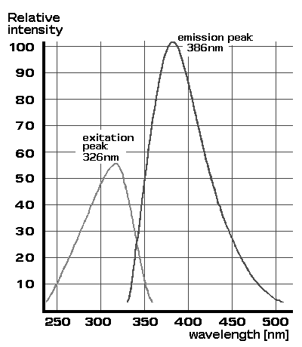
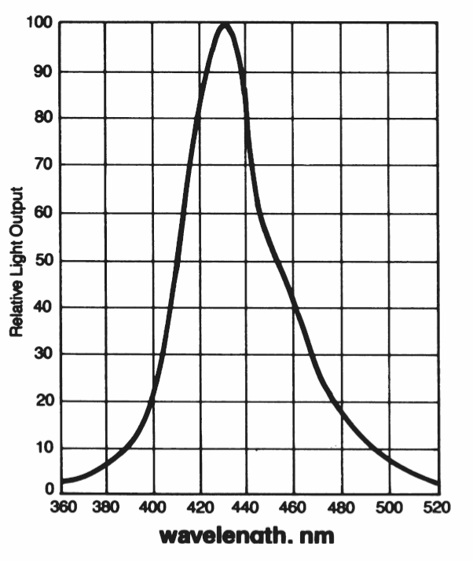
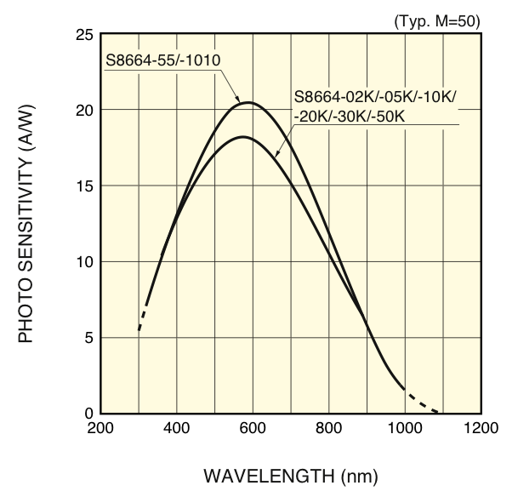
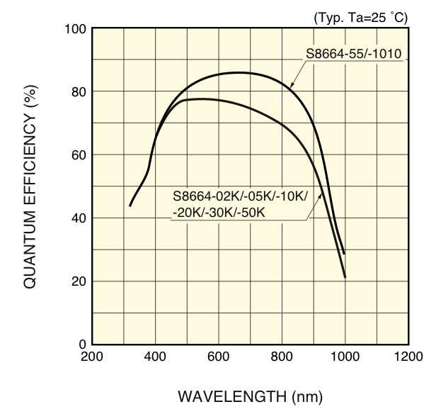
Wavelength Matching
Josiah DeLange
http://www.apace-science.com/ast/g_scint.htm
http://www.crystals.saint-gobain.com/uploadedFiles/SG-Crystals/Documents/SGC%20BC454%20Data%20Sheet.pdf
http://www.hamamatsu.com/resources/pdf/ssd/s8664_series_kapd1012e04.pdf
Lithium-Glass
BC-454 Plastic
S8664 APD
Overview | Approach | Project Plan | Design Walkthrough | FMEA and Safety | Standards | Conclusions
Notes:
FIGURES:
Left: http://www.apace-science.com/ast/g_scint.htm
Middle: http://www.crystals.saint-gobain.com/uploadedFiles/SG-Crystals/Documents/SGC%20BC454%20Data%20Sheet.pdf
Right: http://www.hamamatsu.com/resources/pdf/ssd/s8664_series_kapd1012e04.pdf
Spectral ranges of emission must coincide for any of this to work
Regions of overlap determine approximate shape of the energy spectrum

Slide 24
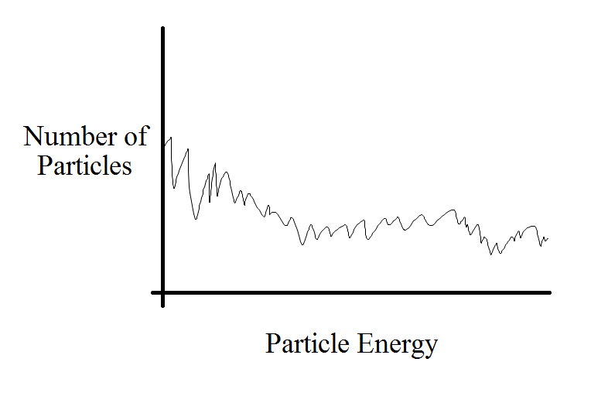
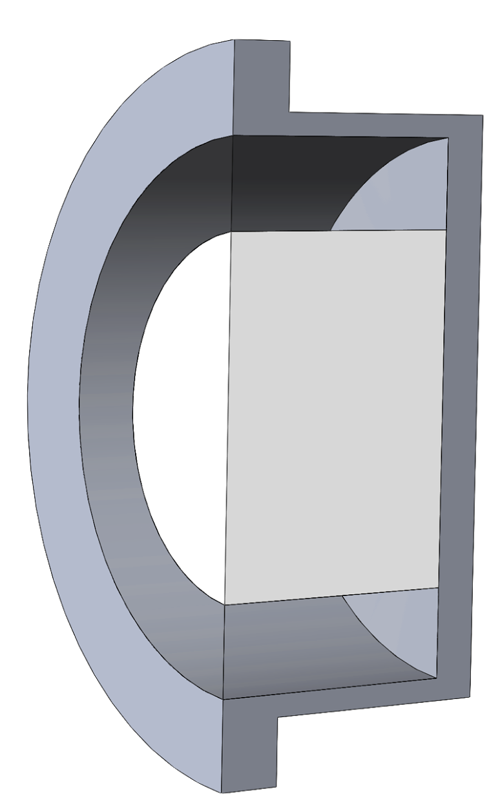
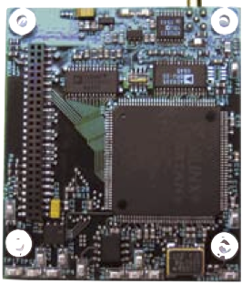
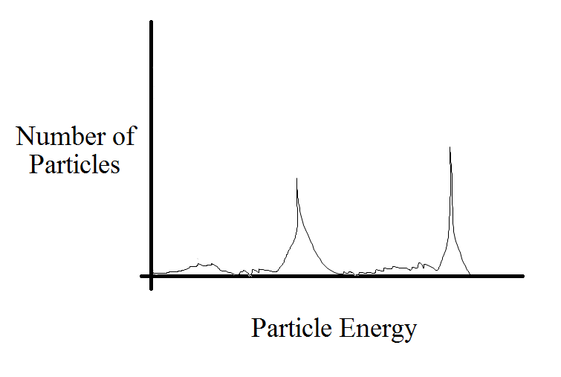
Particle Discrimination
Josiah DeLange
Borated Plastic
Thermal Neutrons
Fast Neutrons
80 MHz ADC clock
12 bit ADC
4 MHz count rate
Peak time of 0.2 us
Lithium-Glass
Overview | Approach | Project Plan | Design Walkthrough | FMEA and Safety | Standards | Conclusions
Notes:
Expect a more grainy, continuous spectrum from the BC-454 detectors; due to a lot of thermal particles and also they are plastic (thus lack resolution)
Expect more distinct peaks from the lithium-glass detectors, as the particles they sense are very high energy

Slide 25
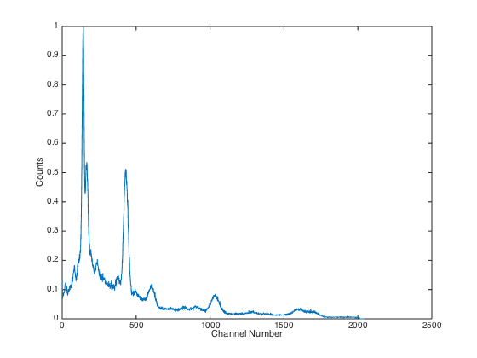
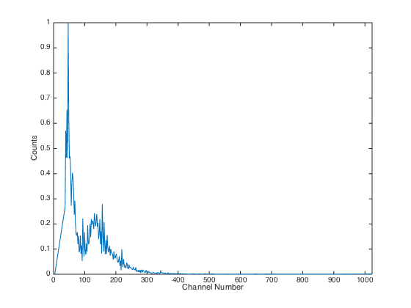
Detector Energy Resolution
Josiah DeLange
NaI(Tl) Detectors
Organic Plastic Detectors
Overview | Approach | Project Plan | Design Walkthrough | FMEA and Safety | Standards | Conclusions
Notes:
FIGURES:
Left: Thorium-232 source, detected using inorganic crystal (NaI(Tl)) detectors; 2048 bins
Right: Thorium-232 source, detected using organic plastic (BC-412) detectors; 1024 bins
No energy levels, just bins, although calibration can be followed through easily with this kind of data
Compare resolution and detectable range of energy for different detector materials

Slide 26
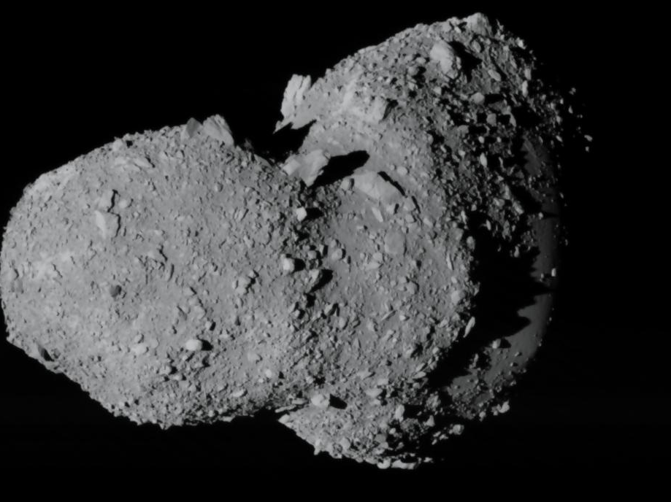
Orbits, Propulsion, Attitude
Seth Merrifield
Propulsion
ADCS
Orbital Determination
Overview | Approach | Project Plan | Design Walkthrough | FMEA and Safety | Standards | Conclusions

Slide 27
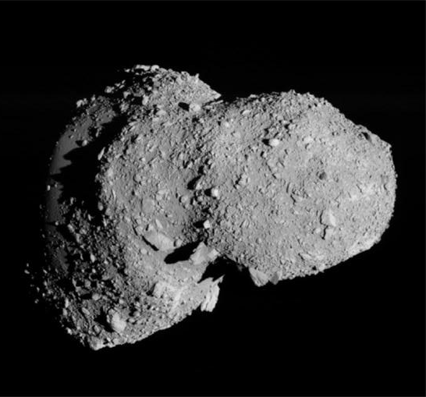
Asteroid Selection
Seth Merrifield
Key: non-monolithic ->
2009 BD
10 m, 80000 kg
a = 1.015 AU
H=28.1
⍵ = 0.005 r/s
Asteroid Itokawa, visited by Hayabusa probe in 2005
http://www.isas.jaxa.jp/e/snews/2005/1102.shtml
Overview | Approach | Project Plan | Design Walkthrough | FMEA and Safety | Standards | Conclusions

Slide 28
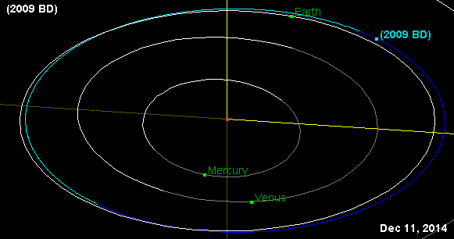
Basic Orbit Determination
Seth Merrifield
Target asteroid: facilitate mission outcome
minimize: time of mission, ΔV
largest potential asteroid from given list
http://ssd.jpl.nasa.gov/sbdb.cgi?sstr=2009%20BD;orb=1
Overview | Approach | Project Plan | Design Walkthrough | FMEA and Safety | Standards | Conclusions

Slide 29
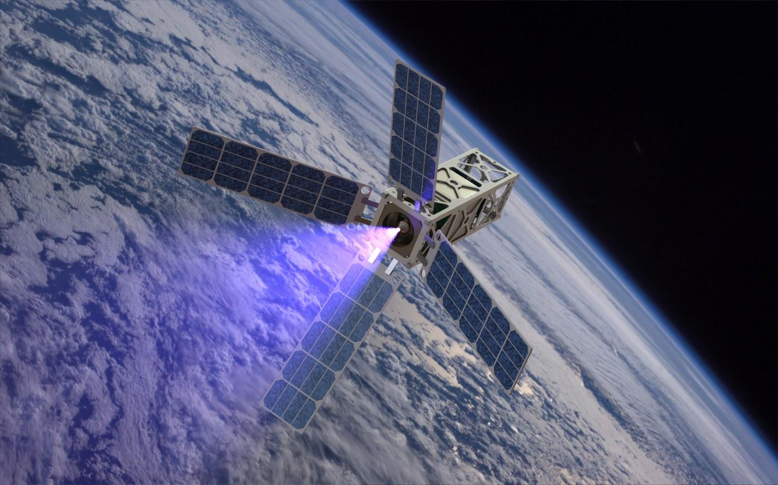
Propulsion : PEPL Ambipolar Plasma Thruster
Designed specifically for this type of mission
Continuous or Pulsed Thrust (2mN vs 20mN thrust)
Exit Velocity = 20,000 m/s
Fuel Required ≈ 2.5 kg [Xe]
Operating Power ~10W
Size ~2U (with fuel)
Still in development
http://pepl.engin.umich.edu/thrusters/CAT.html
Overview | Approach | Project Plan | Design Walkthrough | FMEA and Safety | Standards | Conclusions
Notes:
Design of propulsion not in scope of project → pick off the shelf option
Plasmadynamics and Electric Propulsion Laboratory - University of Michigan
thruster technology will be able to send low-cost satellites from the Earth to go observe and radio-tag asteroids for retrieval
run continuously at periapsis for certain number of degrees or pulse it around periapsis

Slide 30
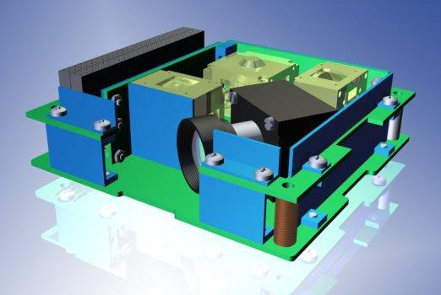
Attitude Determination & Control Requirements
Off-the-shelf iADCS-100 chosen
3-axis reaction wheels/magnetorquers
3-axis accelerometers/magnetometers
Star-tracker, gyro
Velocity Vector Stabilization & Accuracy
< 5° between long axis and velocity vector (95% confidence)
No requirement for roll angle
Velocity Vector Attitude Knowledge
Measure attitude within +/- 1° at the time of receiving data
De-Tumble & Tip-Off Recovery
Recover from tip-off rates up to ~100°/s
Stabilize within 2 days
www.berlin-space-tech.com
Overview | Approach | Project Plan | Design Walkthrough | FMEA and Safety | Standards | Conclusions
Notes:
Velocity Vector Stabilization
Because optimal control law angle found to be ~5deg outward, choose < 5 deg accuracy
De-Tumble
T_req = 0.0502 mN
T_iADCS = 0.087 mN

Slide 31
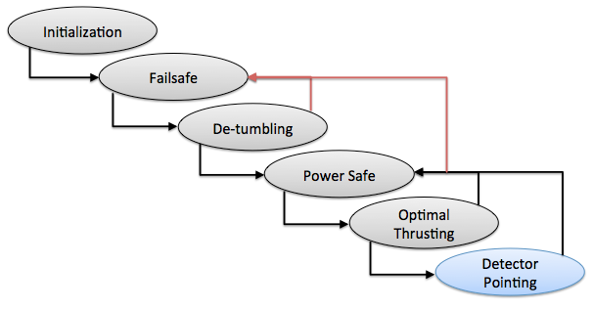
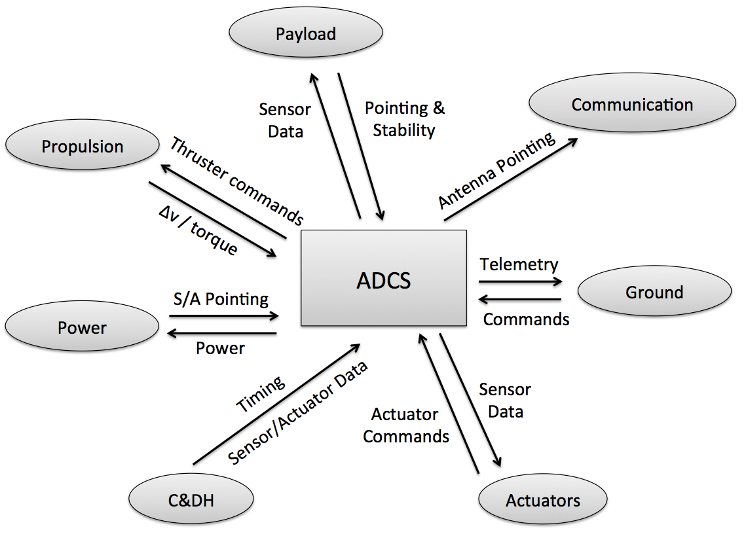
Subsystem Relationships
Modes of Operation
C&DH - May at any time force the ADCS into any state or reboot
Overview | Approach | Project Plan | Design Walkthrough | FMEA and Safety | Standards | Conclusions
Notes:
Subsystem Relationships
Command and data handling system
Transfer Orbit
Initialization - Power supplied for ADCS is supplied. Sensors and actuators are initialized.
Failsafe - ADCS remains on standby until a command from the CHDS allows it to continue to de-tumbling mode.
De-Tumbling - ADCS will de-tumble the satellite. Once complete or not necessary, system continues to Power Safe mode
Power Safe - Attitude of the satellite and deployable solar panels oriented to obtain the maximum power input. Power consumption kept low when satellite is in the shadow of Earth.
Optimal Thrusting - Orient long axis to optimize thrust direction
At Asteroid
Detector Pointing - Change attitude to acquire optimal orientation of detectors for spectroscopy for given time (hour at least)

Slide 32
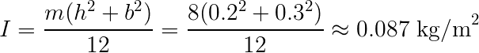
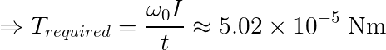
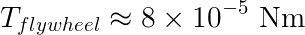
Tip-Off Recovery
Problem : Tip-Off Rate Recovery Rate
Approach : Use maximum moment of inertia to determine the torque of fly-wheels required to stabilize
From simplified analysis, iADCS-100 flywheel torque capability should suffice.
Next step - 3D moments with mass distribution accounted for.

Slide 33
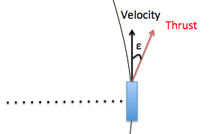
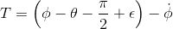
Velocity Vector Stabilization
Problem : Optimizing thrust vector
Approach : Derive the equations of motion and develop MATLAB model
Solutions : Develop optimal torque control law to stabilize thrust vector
Conclusions :
Non-trivial solution
Optimal direction of thrust ≈ 5° from perpendicular
Deviation from optimal direction becomes significant at ~ 5-10°
This determines required accuracy of velocity vector desired
Overview | Approach | Project Plan | Design Walkthrough | FMEA and Safety | Standards | Conclusions
Notes:
non-trivial solution: depends on
the mass of the cubesat
the maximum thrust capability
Optimal direction of thrust kept at 5deg from perpendicular
T is proportional to the difference from the angle being 90degrees
attenuation term phidot, to provide damping to the oscillations

Slide 34
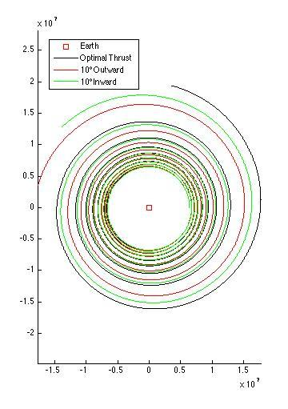
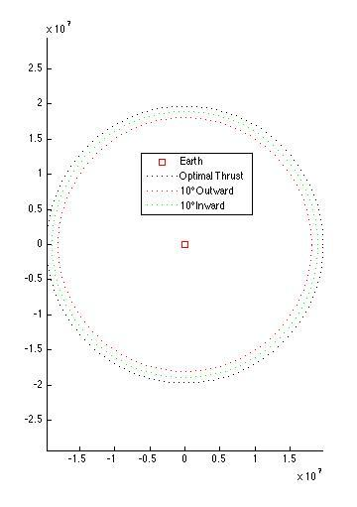
Notes:
Orbital time = 1year
10deg outward from optimal thrust → 3.5% decrease of reach
10deg inward from optimal thrust → 2% decrease of reach
Therefore an accuracy of 5deg

Slide 35
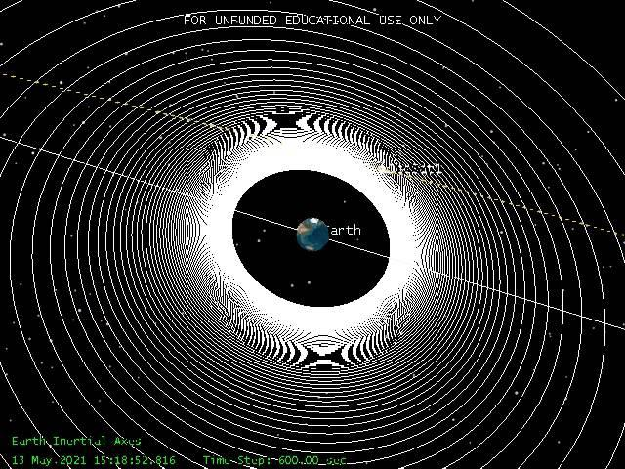
Result of Orbit Determination: Step 1
Seth Merrifield
Overview | Approach | Project Plan | Design Walkthrough | FMEA and Safety | Standards | Conclusions

Slide 36
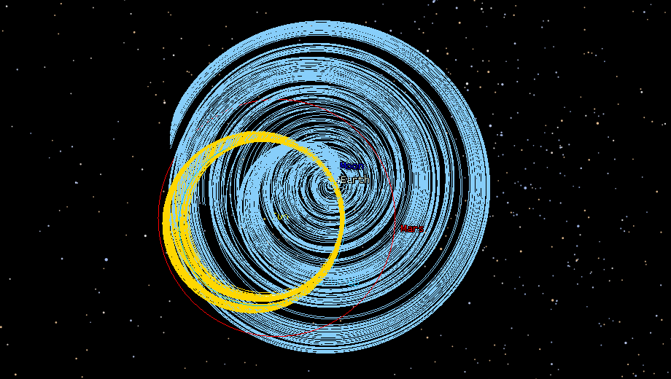
Result of Orbit Determination: Step 2
Seth Merrifield
Overview | Approach | Project Plan | Design Walkthrough | FMEA and Safety | Standards | Conclusions

Slide 37
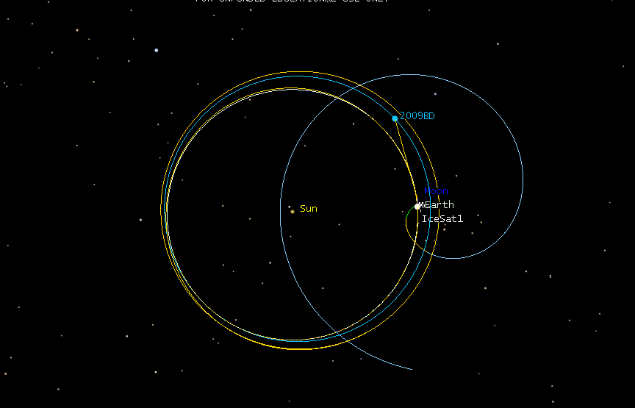
Result of Orbit Determination: Step 2
Seth Merrifield
Overview | Approach | Project Plan | Design Walkthrough | FMEA and Safety | Standards | Conclusions

Slide 38
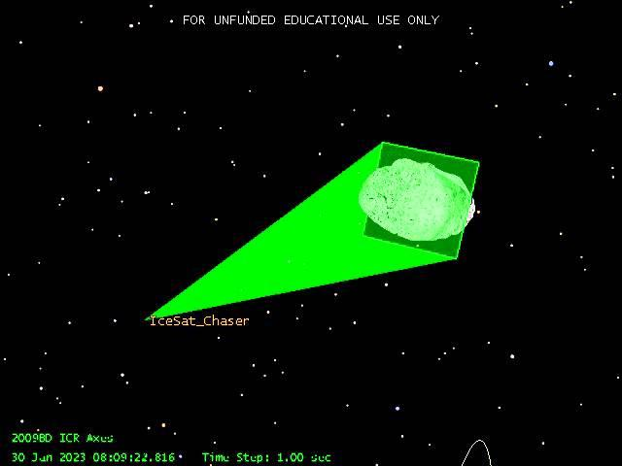
Result of Orbit Determination: Step 3
Seth Merrifield
Overview | Approach | Project Plan | Design Walkthrough | FMEA and Safety | Standards | Conclusions

Slide 39
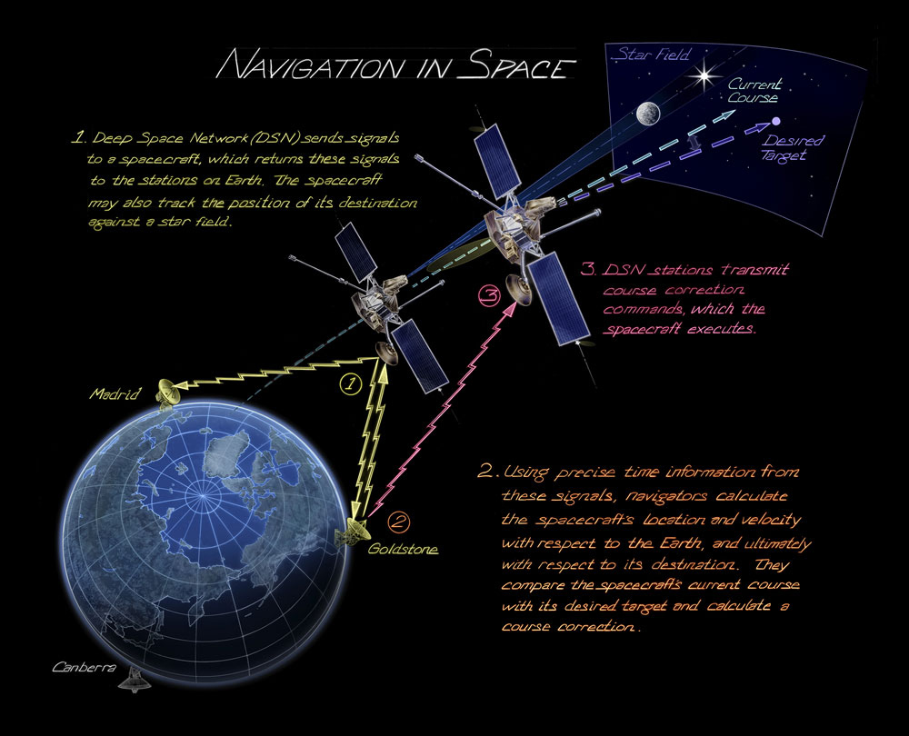
Navigation
Orbital Path Trajectory
Verification
Correction
Asteroid Rendezvous
Primary Means
Deep Space Network (DSN)
Differential One way Ranging
http://timeandnavigation.si.edu/multimedia-asset/navigation-in-space
Yunus Agamawi
Overview | Approach | Project Plan | Design Walkthrough | FMEA and Safety | Standards | Conclusions

Slide 40
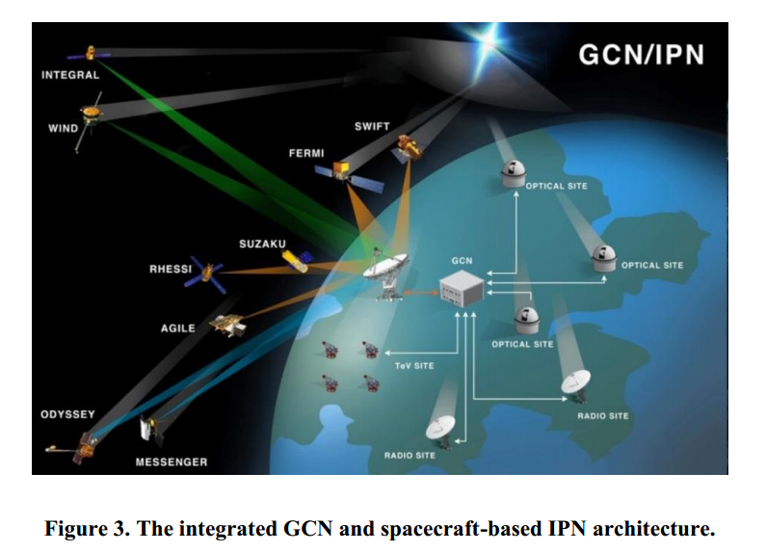
Navigation
Gamma-ray source Localization-Induced Navigation and Timing (GLINT)
Interplanetary Network (IPN)
Gamma-ray Burst Coordinate Network (GCN)
Gamma-Ray Burst Detector
20keV to 3MeV
“Spacecraft Navigation Using Celestial Gamma-Ray Sources”, Chuck S. Hisamoto and Suneel I. Sheikh, AAS Paper 13-144,Advances in the Astronautical Sciences, Proceedings of the 23rd Space Flight Mechanics Meeting, Kauai, HI, Vol. 148, 10-14 February 2013, pp. 3903-3922.
Yunus Agamawi
Overview | Approach | Project Plan | Design Walkthrough | FMEA and Safety | Standards | Conclusions

Slide 41
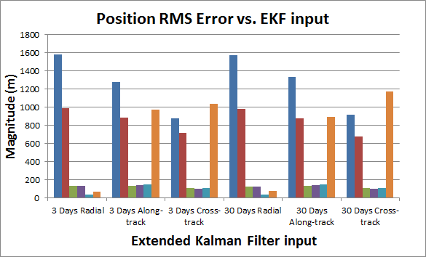
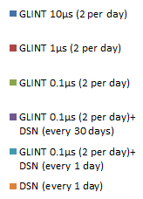
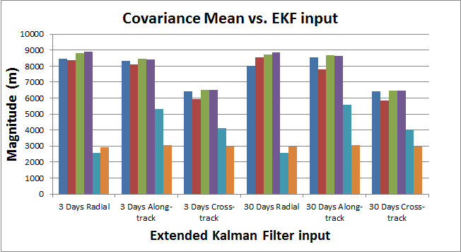
Navigation
High precision onboard clock
Resolution of photon binning
Autonomous navigation and processing capabilities
Remote computation of telemetry path
“Spacecraft Navigation Using Celestial Gamma-Ray Sources”
Yunus Agamawi
Overview | Approach | Project Plan | Design Walkthrough | FMEA and Safety | Standards | Conclusions

Slide 42
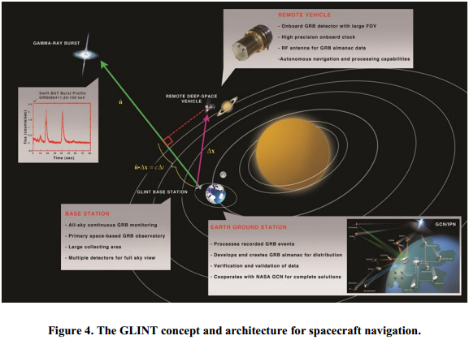
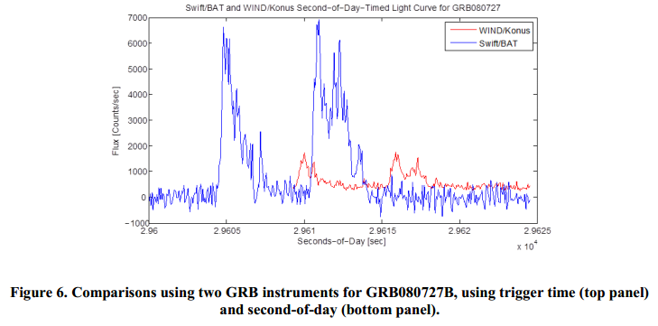
Communication
Transmit sensor findings
Scouting asteroid
Update Navigation Solution
Deep Space Network
Monitoring CubeSat
Nearby Spacecraft
Gamma Ray Burst Almanac
Time of Arrival
“Spacecraft Navigation Using Celestial Gamma-Ray Sources”
Yunus Agamawi
Overview | Approach | Project Plan | Design Walkthrough | FMEA and Safety | Standards | Conclusions

Slide 43
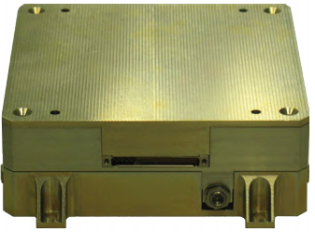
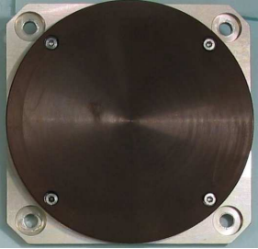
Communication
SWIFT-SLX: S-Band Transceiver (Tethers Unlimited)
Bandwidth communicating over DSN
Meet link budget range requirements
S-Band Patch Antenna (Surre Satellite)
Uplink/Downlink capabilities
Yunus Agamawi
Overview | Approach | Project Plan | Design Walkthrough | FMEA and Safety | Standards | Conclusions

Slide 44
Thermal Control
Haley Rorvick
Operating Temperature Requirements
Subsystem | Components | Operating Temperature
Navigation | Antenna and Transceiver | -20℃ to 50℃
Detection | Photodiodes | -20℃ to 50℃
Detection | Lithium Glass/ Borated Plastic/ Sodium Iodide Crystal | <375℃
Detection | Amplifier Chip | -55℃ to 125℃
Attitude Determination | iADCS-100 module | -20℃ to 40℃
Propulsion | Ambipolar Thruster | N/A
Power | Batteries | 0℃ to 50℃
Power | Solar Panels | 0℃ to 115℃
Required Internal Temperature Range
0℃ to 40℃
Overview | Approach | Project Plan | Design Walkthrough | FMEA and Safety | Standards | Conclusions

Slide 45
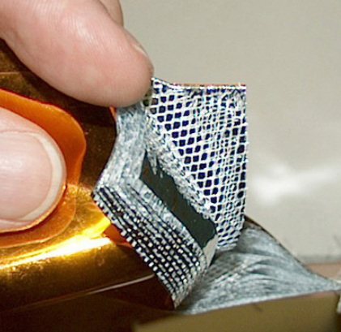
Thermal Control
Space Environment and Thermal Control Components
Haley Rorvick
Thermal Properties of Space
Direct Exposure to Sun: Temperature ≈ 115°C
Based on the orbital path, the CubeSat will be mostly in the sun
Passive Thermal Systems
MLI (Multi-Layer Insulation)
protects against unwanted heating or cooling
Thermal Fillers
Promotes conduction between various electronics and to surface radiators
Solar Panels
Silicon Solar Cells w/ 3mm of glass
Solar panels will keep surface temperature at approximately 20°C
Multi-Layer Insulation
Overview | Approach | Project Plan | Design Walkthrough | FMEA and Safety | Standards | Conclusions

Slide 46
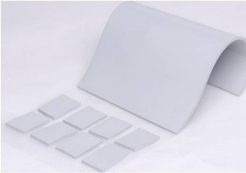
Thermal Control
Haley Rorvick
Thermal Gap Filler (AOK)
Electrically Insulating
Good Thermal Conductivity (0.8 W/m-K)
Naturally Tacky
Continuous Use Temp: -40℃ to 150℃
Thickness: 5mm to 12mm
* In order to conduct testing, arrangements have been made with the company for free samples
Overview | Approach | Project Plan | Design Walkthrough | FMEA and Safety | Standards | Conclusions

Slide 47
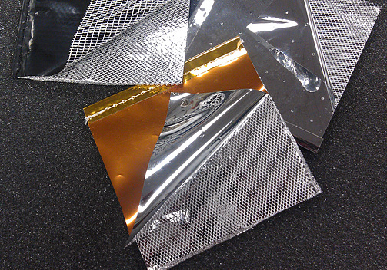
Thermal Control
Haley Rorvick
Multi-Layer Insulation
Conductive heat path is minimized by alternating Layers of Aluminized Mylar and Polyester veil
Number of Layers: 15
Effective Emittance: ~0.003
Verified by NASA research
MLI is extremely sensitive and can break easily
Overview | Approach | Project Plan | Design Walkthrough | FMEA and Safety | Standards | Conclusions

Slide 48
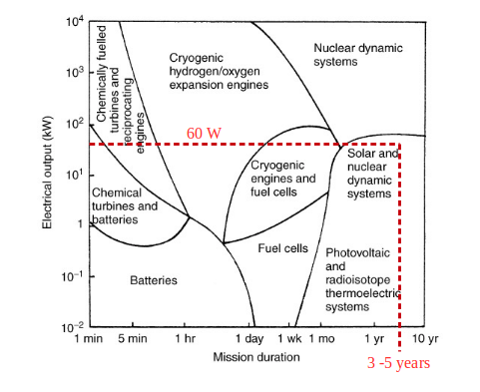
Power
Alec Forsman
Most fundamental requirement for any spacecraft
Determining the proper power system
Length of mission
Power needed
Feasible
Overview | Approach | Project Plan | Design Walkthrough | FMEA and Safety | Standards | Conclusions
Notes:
Insert picture of determining power systems

Slide 49
Solar Array Sizing
Alec Forsman
Determining power consumed
Consumption is not always equal to production
Array Regulator
Power Control and Distribution Unit (PCDU)
Component | Power Consumption (W)
S-Band Patch Antenna | 10
SWIFT-SLX: S-band SGLS/USB/ISM Transceiver | 8.7
iADCS-100 | 1.8
CubeSat Ambipolar Thruster | 10
Detector System | 6
Battery Recharging | 23.35
Total Power | 59.85 (~60)
Overview | Approach | Project Plan | Design Walkthrough | FMEA and Safety | Standards | Conclusions
Notes:
edit figure
Area equation, what affects power produced, what we’ll be operating in, potential concerns

Slide 50
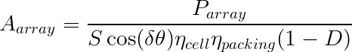

Solar Array Sizing
Alec Forsman
Array Size: 3315 cm²
Factors Affecting Array Sizing | Value
Power Needed (P_{array}) | 60 W
Solar Flux (S) | 1270 W/m²
Array Pointing Accuracy (δθ) | 1°
Solar Cell Efficiency (η_{cell}) | 29 - 0.08T
Cell Packing Efficiency (η_{packing}) | 0.90
Array Degradation Factor (D) | 0.20
Temperature (T) | 0-115°C
Overview | Approach | Project Plan | Design Walkthrough | FMEA and Safety | Standards | Conclusions
Notes:
insert graph

Slide 51
Solar Array Sizing
Alec Forsman
Arrangement on CubeSat
Solar panel area: 3315 cm²
Area of 6U: 3168 cm²
Effective Area: 1815 cm²
Angle of sunlight irradiance: Ψ = 35°
Area of deployed solar panels: 1500 cm²
Area of single deployed panel: 750 cm²
w ~ 20 cm & l ~ 37.5 cm
Overview | Approach | Project Plan | Design Walkthrough | FMEA and Safety | Standards | Conclusions

Slide 52

Off the Shelf Options
Alec Forsman
Clyde Space
6U panel array
Offer customization option
Technical Readiness Level: 2
Single wall panel for a 6U CubeSat
Overview | Approach | Project Plan | Design Walkthrough | FMEA and Safety | Standards | Conclusions

Slide 53

Batteries
Alec Forsman
Need to supply power in Earth’s umbra
Determined by the period of eclipse
Overview | Approach | Project Plan | Design Walkthrough | FMEA and Safety | Standards | Conclusions
Notes:
Picture of clyde space battery (x)
determined by eclipse time, equation to det bat enegy, clyde space bat 30whr, potential problems(cycle life)

Slide 54


Battery Sizing
Alec Forsman
Max time spent in eclipse: ~1.867 hr
(E_{B})_{max}= 85 Whr
η_{charge} = 95%
DOD = 70%
3 x 30Whr needed
Clyde Space
30 Whr standalone battery offered by Clyde Space

Slide 55

Battery effects on Power
Alec Forsman
Need to be able to recharge the batteries
Max power needed
~23.65 W

Slide 56
Radiation Background
Alec Forsman
Earth Radiation Zone - Van Allen Radiation Belt
Inner Belt - proton dominated
Outer Belt - electron dominated
Auroral Zone
Low energy electrons
Low percentage of protons
Interplanetary Zone
Solar wind
Continuous ejection of protons and electrons
Solar flares
Large flares - extremely rare
Small flares - occur approximately 8 times a day
Cosmic flux
Originate from supernovae, active galactic nuclei and gamma ray bursts

Slide 57
Radiation Effects
Alec Forsman
Degradation of internal components
Degradation of solar array performance
Displacement damage
UV exposure darkens cover glass
Decreases Illumination & increases operating temperature
Single-event upsets
Produces false commands
Dielectric charging
Embrittlement
Overview | Approach | Project Plan | Design Walkthrough | FMEA and Safety | Standards | Conclusions

Slide 58
Radiation Protection
Alec Forsman
Internal Components
Radiation Hardening
Shielding from aluminum structure and solar panels
Solar Array
Increase cover glass thickness
Reduction in energy conversion efficiency is inevitable
Design for this (EOL)
Array degradation factor (D)

Slide 59
FMEA and Safety
Overview | Approach | Project Plan | Design Walkthrough | FMEA and Safety | Standards | Conclusions

Slide 60
FMEA and Safety | FMEA Overview
John Jackson
Total FMEA elements : 132
Critical subsystem FMEA elements:
Propulsion
Power
Mission Orbit
Overview | Approach | Project Plan | Design Walkthrough | FMEA and Safety | Standards | Conclusions

Slide 61
FMEA and Safety | Top FMEA Elements
John Jackson
Subsystem | Failure mode | Probability | Severity | CON
Orbital | orbital transfer miscalculated | 4 | 10 | 40
Power | End of Life (EOL) not designed high enough | 5 | 8 | 40
ADCS | Reaction Wheel Fails | 4 | 10 | 40
Power | Cell failures occur | 6 | 6 | 36
Orbital | engine does not perform at expected level | 5 | 7 | 35
Power | Mission takes longer than expected and solar panels degrade | 5 | 7 | 35
Power | Solar panels cant produce enough power for mission duration | 4 | 8 | 32
Overview | Approach | Project Plan | Design Walkthrough | FMEA and Safety | Standards | Conclusions

Slide 62
FMEA and Safety | Safety Concerns
John Jackson
Care needs to be taken with propulsion
Propulsion unit, solar panels
Possibility of collision with other spacecraft
nature of orbit leaving Earth
Need to coordinate with appropriate agencies to minimize risk
NASA, ESA, etc.
Overview | Approach | Project Plan | Design Walkthrough | FMEA and Safety | Standards | Conclusions

Slide 63
Appropriate Standards
Overview | Approach | Project Plan | Design Walkthrough | FMEA and Safety | Standards | Conclusions

Slide 64

Appropriate Standards | CubeSat Design
John Jackson
CubeSat Design Standard - Cal Poly
Regulates design of 1-U to 3-U CubeSats
Larger CubeSats being explored for the future
Deviation Waiver Approval Request
Required if some design specs are different
Overview | Approach | Project Plan | Design Walkthrough | FMEA and Safety | Standards | Conclusions

Slide 65
Appropriate Standards | Procedure Standards
John Jackson
NOAA Remote Sensing License
Required for non-government remote sensing spacecraft
LSP Program Level P-POD and CubeSat Requirements Document (LSP-REQ-317.01)
NASA’s requirements for P-POD launcher
General Environmental Verification Standard for GSFC Flight Programs and Projects (GSFC-STD-7000)
System and environment testing for space systems
Overview | Approach | Project Plan | Design Walkthrough | FMEA and Safety | Standards | Conclusions

Slide 66
Appropriate Standards | Procedure Standards
John Jackson
Military Standard Test Requirements for Launch, Upper-stage, and Space Vehicles (MILSTD-1540)
In-depth procedure on environment and system verification
Air Force Space Command Manual 91-710, Range Safety User Requirements Manual (AFSPCMAN 91-710)
Guidelines for safety and minimum design requirements for safety-critical missions
Standard Materials and Processes Requirements for Spacecraft (NASA-STD-6016)
Minimum requirements for NASA spacecraft materials and processing
Overview | Approach | Project Plan | Design Walkthrough | FMEA and Safety | Standards | Conclusions

Slide 67

Appropriate Standards | Procedure Standards
John Jackson
NASA Procedural Requirements for Limiting Orbital Debris (NPR 8715.6)
Guidelines on minimizing space debris production
NASA Procedure for using DSN, SN
To communicate with spacecraft
Many, many others
Standard modelling practices, environmental standards
Navigation radio standards
Overview | Approach | Project Plan | Design Walkthrough | FMEA and Safety | Standards | Conclusions

Slide 68
Conclusions
Overview | Approach | Project Plan | Design Walkthrough | FMEA and Safety | Standards | Conclusions

Slide 69

Conclusions
Subsystem Technical Readiness Level:
Detection: 4
Processing: 2
Propulsion: 2
Communication: 2
Power Control: 2
Mission Technical Readiness Level:
2
Alternative hardware to consider:
External optical sensors
Ranging device
[laser rangefinder]
Solid-state radiation detectors
Different detector geometries
Overview | Approach | Project Plan | Design Walkthrough | FMEA and Safety | Standards | Conclusions

Slide 70
Life Long Lessons
Alec Forsman
Adhering to a strict schedule
Communication is key
The engineering process is a while(1) loop
Converge on a solution
Have to learn to accept certain standards
There most likely isn’t a right answer
There will always be room for improvement
Time is your most valuable resource

Slide 71
Individual Design Contributions
Alec Forsman
Feasibility assessment
Power, mass, size
Are we even close?
Power
Designed Solar Panels from the ground up
Batteries needed
Radiation
Determined the effects
Found ways to minimize damage

Slide 72
Formulating Requirements
Alec Forsman
Solar Panels:
Power vs. Solar Panel Area
Infinite area = Infinite power
Accurate estimation of parameters
Choosing what environment to model
Interplanetary
LEO
GEO
Can we survive a worst case scenario?
Batteries:
Power they need to produce
Amount of time in eclipse
Number of batteries needed
Worst case was 9
Can they be recharged?

Slide 73

Engineering Methodology
Alec Forsman

Slide 74
Engineering Methodology
Use Matlab to

Slide 75
Individual Design Contributions
Propulsion:
Researched available propulsion to determine adequate thrusters for mission
Busek, Clyde Space, PEPL, NASA, ESA
Wrote MATLAB function to approximate fuel required/consumption
Orbit :
Developed MATLAB model of planar orbit to determine ADCS specifications
Velocity Vector / Tip-Off Recovery
Determined optimal thrust vectoring through iteration
ADCS :
Researched available ADCS to be able to meet mission specifications
Torque capability → Tip-Off Recovery Time
Developed understanding of sensitivity through simulation
Notes:
Addressed issues in several areas

Slide 76
Thomas - Ability to formulate Design Req.
Thruster requirements based on:
Size
Fuel consumption for mission
ADCS requirements based on:
Velocity vector accuracy
developed from analysis of MATLAB orbital model
Actuator torques

Slide 77

Engineering Methodology: Fuel Required
Tsiolkovsky Rocket Equation
For PEPL Ambipolar Thruster
Assumes impulsive maneuver
Ignores friction from Earth’s atmosphere

Slide 78
Engineering Methodology: Actuator Requirements
From simplified analysis, iADCS-100 flywheel torque capability should suffice.
Next step - 3D moments with mass distribution accounted for.

Slide 79









Engineering Methodology: Planar Orbit Simulation
Using the Lagrangian
Torque control law:
optimized to maximize orbit reach through iteration

Slide 80

Thomas - Lessons Learned

Slide 81



Thomas - Lessons Learned
Timing
Direction is crucial
Importance of Planning
Problem Solving & Persistence
Notes:
Get things done on time, especially when others depend its completion
Knowing where a project is headed is crucial to doing good/productive work

Slide 82
Individual Design Contribution
Yunus Agamawi
Navigation Systems
Deep Space Network
Navigation Aid
Communication Systems
Relaying Data/Commands
Mission Control
Sensor findings
Total Hours: 72

Slide 83
Specific Design Requirements
Navigation Aid
Detection system
Transmit/Receive Data
Relay sensor findings
Transmitter/Antenna Power
Navigational information
Mission Commands
Receiver/Antenna Power
Yunus Agamawi

Slide 84

http://en.wikipedia.org/wiki/Global_Positioning_System
http://eecue.com/a/1581/Goldstone-NASA-Deep-Space-Network.html
Yunus Agamawi

Slide 85

Equivalent Isotropic Radiated Power, EIRP
P_{T} - transmission power
0dB
L_{T} - transmission loss
1.5dB (LEO satellites)
G_{T} - transmission antenna gain
8dB
EIRP = P_{T} – L_{T} + G_{T}
_{EIRP = 0dB - 1.5dB + 8dB}
_{EIRP = 36.5dBm}
http://www.space.aau.dk/cubesat/galleri1.html
Yunus Agamawi

Slide 86

Propagation Losses, L_{prop}
http://www.aboutcivil.org/sources-of-errors-in-gps.html
FSL - Free Space Loss
246dB (0.15AU range)
L_{abs} - Atmospheric Absorption
0.1dB (precedence)
L_{pol} - Polarization Loss
3dB (precedence)
L_{aml} - Antenna Misalignment Loss
1dB (precedence)
L_{prop} = FSL + L_{abs} + L_{pol} + L_{aml}
L_{prop} = 246dB + 0.1dB + 3dB + 1dB
L_{prop} = 250.1dB
Yunus Agamawi

Slide 87

Link Budget:
Received Power, P_{R}
http://www.spacetoday.org/SolSys/DeepSpaceNetwork/DeepSpaceNetwork.html
EIRP – Equivalent Isotropic Radiated Power
36.5dBm
L_{prop} - Propagation Loss
250.1dB
L_{R} - Receiver Loss
1.5dB (analogous to transmitter loss)
P_{R} = EIRP - L_{prop} - L_{R}
P_{R} = 6.5dB - 250.1dB - 1.5dB
P_{R} = -244.9dB
Yunus Agamawi

Slide 88
Link Budget: Carrier to Noise, C/N
T_{S} - System noise temperature
18.8dBK (precedence)
k - Boltzmann constant
228.6dB/K/Hz
P_{R} - Power Received
245dB
G_{R} - Receiver Gain
85.9dB
C/N = P_{R} + G_{R} - T_{S} - k
C/N = -244.9dB + 85.9dB - 18.8dBK + 228.6dB/K/Hz
C/N = 50.6dB
Yunus Agamawi

Slide 89
Link Budget: Downlink Margin
E_{b}/N = C/N + BitRate
E_{b}/N = 50.6dB/Hz - 40dBHz
E_{b}/N = 10.6dB
BitRate – bit frequency
1/9600 Hz ≈ -40dBHz
E_{b}/N - Energy per bit to noise
BER, Bit Error Rate
For less than 10⁻⁵ errors
BER = -9.6dB
Downlink Margin = E_{b}/N + BER
Downlink Margin = 10.6dB - 9.6dB
Downlink Margin = 1dB
Yunus Agamawi

Slide 90
Link Budget: Uplink Margin
EIRP_{S} = 56dB - 1.5dB + 85.9dB = 140.4dB
L_{PROPS} = 246dB + 0.1dB + 3dB + 1dB = 250.1dB
P_{RS} = 140.4dB - 250.1dB - 1.5dB = -111.2dB
C/N_{S} = -111.2dB + 8.0dB - 18.8dBK + 228.6 dB/KHz = 106.6 dB/Hz
E_{B}/N_{S}= 106.6dB/Hz - 40dbHz = 60.6dB
Uplink Margin = 60.6dB - 9.6dB = 51dB
Yunus Agamawi

Slide 91

Life–Long Learning
Turning big, hairy, audacious goal into smaller, conquerable tasks
Defining roles and accountability evenly between members
Yunus Agamawi
http://www.daimanuel.com/my-super-top-secret-hack-that-accelerates-your-fitness-goals-that-works-nearly-every-single-time/

Slide 92

Life–Long Learning
Assessing team member strengths
Delegating responsibilities accordingly
Recognizing and handling unexpected issues and complications
http://blog.bluechipcommunication.com.au/wp-content/uploads/2012/09/
Yunus Agamawi

Slide 93

Seth - Life Long Learning
Aerospace/Technology
Remote Sensing, propulsion, asteroids...
Professional development
Teamwork, teamwork, teamwork
team integration
prioritization and time management
working mindfully
communicating effectively
http://www.asterank.com/3d/

Slide 94
Seth - Individual Design Contributions
Address broad concerns about mission architecture
Independent CubeSat or fleet with mothership?
Is a transfer possible with a CubeSat?
Engine? Targets?
If not, what kind of mothership do we use?
ETC…
Given assumptions, is this project possible?
Seth Merrifield

Slide 95
Design Contribution
Approach: research, research, model, repeat
U Mich PEPL Lab, NASA, ESA, Busek, STK
Relevance: proof of concept
No project without asteroid, no asteroid without engine
Results: feasibility assessment, illustration
Use STK to look at orbits and see if they work
Illustrate design concepts
Insight into process for potential test flight planning
Seth Merrifield
Notes:
Your goal is to explain what you did, how you did it, why it was important to the overall project, and how it turned out. Report any significant effort even if the results were NOT used in the final design. Design studies not used are still valid work and should be presented. It may be necessary for team members to repeat some material that is common to your individual work. Try to minimize this but some repetition will be tolerated

Slide 96
Seth - Ability to formulate Design Requirements
Estimate minimum ΔV using Kepler’s Equations
Research engine technology to select promising candidates
use STK to model mission using selected engine
create engine model
use JPL data to create SPICE file for STK
Seth Merrifield

Slide 97
Seth - Engineering Methodology
Estimate orbital transfer requirements
back of the envelope estimates to start
inform propulsion decision making
help decide on asteroid
Determine feasibility
CubeSat transfer parts
leave SOI
change orbit around sun to match asteroid
importance of epoch
chase asteroid
Seth Merrifield

Slide 98
Seth - Engineering Methodology
STK custom propulsion modelling
Also: Space Effects and Environment Tool (SEET), solar flux, performance over time, model articulation, radiation pressure, comm-systems
Making educated guesses
initializing STK model
formulating general mission procedure
STK for heavy lifting/calculation
Propagators: Astrogator, HPOP, Heliocentric
JPL Horizons: SPICE files for asteroid data
Seth Merrifield

Slide 99

Optimization
Seth Merrifield

Slide 100

Optimization
Seth Merrifield

Slide 101

Example STK report - sun illumination times
Seth Merrifield

Slide 102

STK report: solar intensity over time
Seth Merrifield

Slide 103

Life Long Learning
Requirements, requirements, requirements
The chicken and the egg
Project suffered from lack of
Relationship Dynamics
Frustration is cumulative
Project Strategy
“Get your work done”
Time is Precious
Documentation
John Jackson

Slide 104

Individual Design Contributions
Project Strategy
Pushed to define requirements early
Tried to keep us on track
Provided literature - Space Systems Engineering
System Architecture Overview
Subsystem breakdown
System modelling
Began ADCS Modelling
CDR Planning
FMEA and Standards
Next semester proposal and build plan
John Jackson

Slide 105
Design Requirements
CubeSat Standards
No 6-Us currently launched
Certain mass and geometry constraints
Spring Semester Build
Adapt our project for HASP requirements
John Jackson

Slide 106
Engineering Methodology
Engineering References
Spacecraft Systems Engineering 4th
Previous / current CubeSat missions
ARKYD testbeds
Simulation in Simulink
Writing on a whiteboard
John Jackson

Slide 107
Lifelong Lessons
Importance of openness
Tell everyone what you did (and why)
Tell everyone what you didn’t do (and why)
Important social conventions
High-quality work follows from continued peer recognition
Interpersonal skills can make or break a team’s cooperation
Meetings as a way to communicate (but not simultaneously)
Miscellaneous
Clear, logical objectives
Positive attitude despite setbacks
Accepting disagreement as being useful for progress
Create enthusiasm and initiative
Josiah DeLange

Slide 108


Individual Design Contributions
Josiah DeLange
Borated Plastic
Thermal Neutrons
Fast Neutrons
Lithium-Glass

Slide 109
Formulating Design Requirements
Josiah DeLange
Examine previous missions/methods for remote sensing
Define mission goals: locate water, detect gamma rays
Research of basics of current technology
Lots of reading on particle physics
Produce technical summaries (or check datasheets, etc.)
More reading on particle physics

Slide 110
Engineering Methodology: Photosensors
Josiah DeLange
Photoelectric Effect
Convert light into a detectable electronic signal
Photons -----> photo-electrons
Terminology
Photon Detection Efficiency (PDE) - ratio of incident photons to output pulses
Quantum Efficiency (QE) - ratio of photo-electrons to absorbed photons
Available Devices
Photomultiplier tubes [uses photocathode + dynode chain]
Photodiodes [standard semiconductor device]
Silicon photomultipliers [pixelated photodiodes; Geiger mode of operation]
Micro channel plate [“continuous” dynode chain”]

Slide 111
Refining Design Requirements
Josiah DeLange
Scintillation Material Requirements
High efficiency for conversion of excitation energy fluorescent radiation
Transparency to its fluorescent radiation to allow transmission of light
Emission of light in a spectral range detectable for photosensors
Short decay time to allow fast response
Photosensor Requirements
High photon detection efficiency
High quantum efficiency

Slide 112
Engineering Methodology: High Gain Photosensors
Josiah DeLange
High-energy
particle
Photocathode
Dynodes
Anode
R
R
R
R
V_{B}
1 electron
10⁶ electrons
“Dynode Chain” PMT
Scintillator
Notes:
Initial electron is accelerated toward first dynode (high bias voltage induces electric field)
Additional electrons produced due to electron avalanche process
Etc; resulting gain of roughly 10⁶
Pros
Ideal for small signals, i.e. single particle detection
Resulting electric signal is sufficiently amplified
Cons
Physical size (larger PMTs require a higher bias voltage)
Sensitivity to magnetic fields
Power requirements

Slide 113
Engineering Methodology: High Gain Photosensors
Josiah DeLange
Cathode
Reflective PTFE tape
High-energy
particle
Light Pulse
Aluminum Housing
N
P
Scintillator
hole
depletion region
P+
Anode
10⁶ electrons
1 electron

Slide 114



Haley- Lifelong Learning

Slide 115

Haley- Communication
http://deseng.ryerson.ca/~fil/t/

Slide 116
Haley- Individual Design Contributions
CubeSat Structure
Followed the standard 6U cubesat shell
6061-T6 Aluminum
Total Mass: 10 kg (estimated using SolidWorks)
Dimensions: approximately 12 cm× 24 cm× 36 cm
Thermal Control
Important in order to keep electronics within their operating temperatures
Multi-Layer Insulation
Thermal Fillers
Verification of Solar Panel absorption and emittance

Slide 117
Haley- Formulation of Design Requirements
Solar Radiation Intensity
J=P/(4πd²)
J=(3.856 × 10²⁶ W)/(4π×(1.56×10¹¹ m)²)
J=1260.89 W/m²
Temperature at 1.015AU (Full Sun)
J=σT⁴
T=(J/σ)^{1/4}
T=[(1260.89 W/m²)/(5.6703×10⁻⁸ W/m²/K⁴)]^{1/4}
T= 386.16K = 113°C

Slide 118

Haley- Formulation of Design Requirements
Equilibrium Temperature and Required Surface Finish
The ratio of absorption versus emittance must be 1.1 for the surface of the CubeSat in order to keep an equilibrium temperature of 25℃.
β = 1.1
https://wiki.umn.edu/pub/Asteroid/WebHome/75901_11.pdf

Slide 119

Haley- Engineering Methodology
Solar Cell Selection
Based on the β found for the required temperature
Compared multiple solar cell options
Based on the table, a Silicon cell with 3mm glass was chosen
β (Si w/ glass) = 1.1

Slide 120

Haley- Engineering Methodology
Temperature in Full Sun
with Solar Cells
T ~ 20℃
Variables
α: absorption of solar cells
Fₚ: packing factor of solar array
e: solar cell efficiency
Af: frontal area of solar array
Ab: back area of solar array
Ap: projected area
S: solar constant (1356 W/m^2)
εf: emissivity of front of solar array
εb: emissivity of back of solar array

Slide 121

Haley-Engineering Methodology
Modeling Using Simulation Software
SolidWorks Simulation
3 mm thickness Si layer on outside with ε=0.84 to simply model solar panels
Inside layer modeled with 6061-T6 Aluminum
Surface to ambient radiation
T (Inside): 37℃
T (Outside): 22℃
Challenges were
encountered while trying to
thermally model the entire
CubeSat
Outside of CubeSat
Inside of CubeSat

Slide 122

Haley-Engineering Methodology
Multilayer Insulation
Shiny surface reflects radiation while the layers reduce the heat lost
Used research from NASA to select the 15 layers.
As the number of layers increase, the lower the thermal conductivity and emittance
ε = 0.003
MLI is very fragile and could be damaged during launch.
Surface finish under the insulation will be white (low absorption coefficient)
http://matthewwturner.com/uah/IPT2008_summer/baselines/LOW%20Files/Thermal/Spacecraft%20Thermal%20Control%20Handbook/05.pdf

